Slide 1
Android Training: Day 5

Slide 2
Material Design
Introduction to Material Design

Slide 3
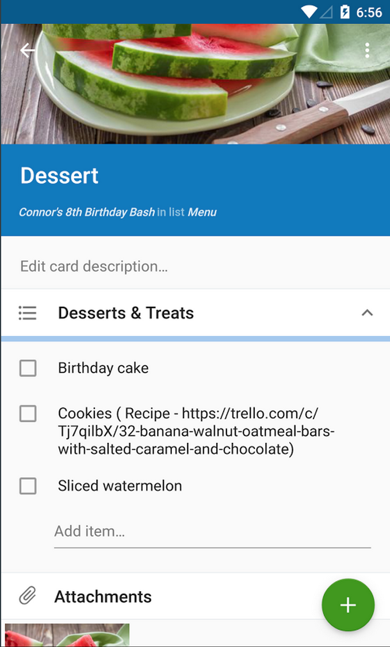
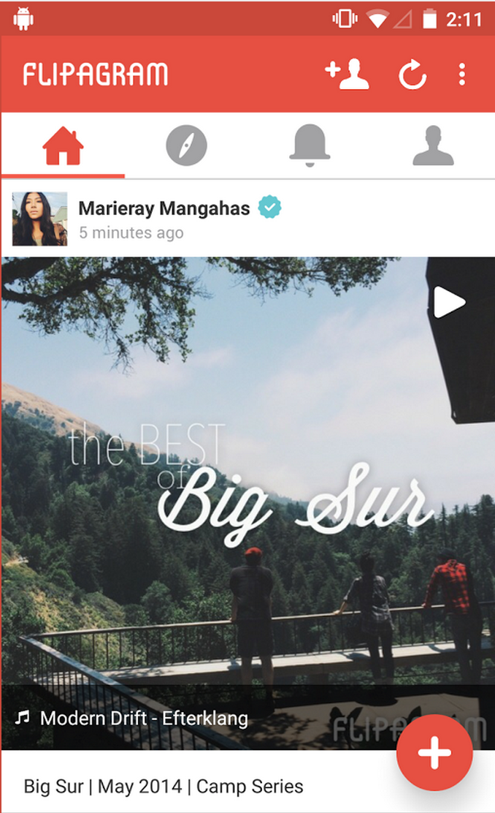
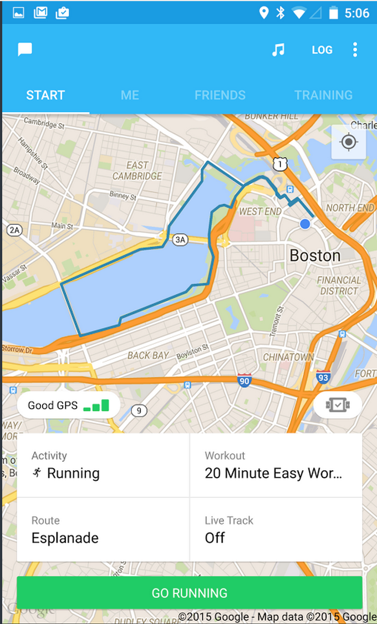
Overview
ToolBar
Floating Button

Slide 4
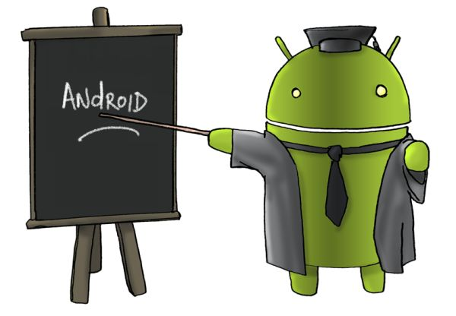
Overview
Material design is a comprehensive approach to visual, interaction and motion design for the multi-screen world.
Android 5.0 Lollipop and the updated support libraries help you to create material UIs.
Android provides the following elements for you to build material design apps:
A new theme
New widgets for complex views
New APIs for custom shadows and animations

Slide 5
Material Design
Set Up

Slide 6
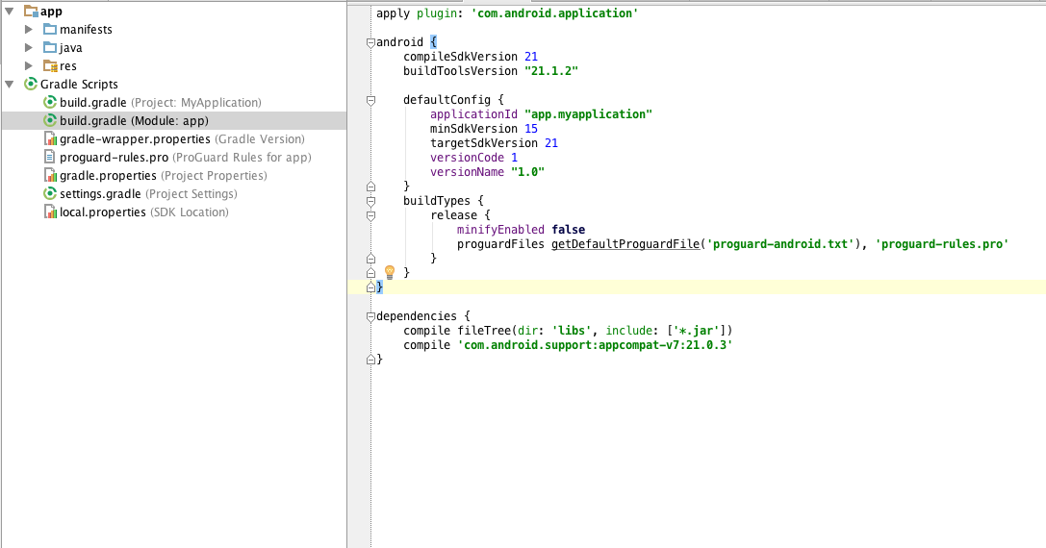
Set Up
Include Support Library

Slide 7
Maintaining Compatibility
Define Alternative Styles
You can configure your app to use the material theme on devices that support it
and revert to an older theme on devices running earlier versions of Android:
Define a theme that inherits from an older theme (like Holo) in res/values/styles.xml.
Define a theme with the same name that inherits from the material theme in
res/values-v21/styles.xml.
Set this theme as your app's theme in the manifest file.
Note: If your app uses the material theme but does not provide an alternative theme in this
manner, your app will not run on versions of Android earlier than 5.0.

Slide 8
Backwards Compatibility
One of the biggest changes in Android 5.0 is the user interface with the introduction of Material Design.
Making use of Material Design and putting best design practices to use, takes a lot of consideration and work on the part of the developer.
For existing apps, developers are faced with further challenges, such as how to leverage the new features of 5.0 whilst maintaining backwards compatibility, providing a consistent user experience across different API levels.
menu-v21/: This contains a copy of the menu_main.xml and will be used to display Material Design icons on Android 5.0 devices.
values-v11/: This contains a styles.xml file that sets the base theme to holo.light for all devices running Android 3.0 or above. Appearance changes to the action bar have also been made in this file.
values-v21/: This contains a styles.xml file that sets the base theme to material.light for devices running on Android 5.0 and above. It also defines the base colors.

Slide 9
Maintaining Compatibility
Provide Alternative Layouts
Create your layout files for Android 5.0 (API level 21) inside res/layout-v21/ and your alternative layout files for earlier versions of Android inside res/layout/.
For example, res/layout/my_activity.xml is an alternative layout for res/layout-v21/my_activity.xml.
To avoid duplication of code, define your styles inside res/values/, modify the styles in res/values-v21/ for the new APIs, and use style inheritance, defining base styles in res/values/ and inheriting from those in res/values-v21/.
Material design v21
<!-- extend one of the Theme.AppCompat themes -->
<style name="Theme.MyTheme" parent="Theme.AppCompat.Light">
<!-- customize the color palette -->
<item name="colorPrimary">@color/material_blue_500</item>
<item name="colorPrimaryDark">@color/material_blue_700</item>
<item name="colorAccent">@color/material_green_A200</item>
</style>

Slide 10
Maintaining Compatibility
Check System Version
The following features are available only in Android 5.0 (API level 21) and above:
Activity transitions
Touch feedback
Reveal animations
Path-based animations
Vector drawables
Drawable tinting
// Check if we're running on Android 5.0 or higher
if (Build.VERSION.SDK_INT >= Build.VERSION_CODES.LOLLIPOP) {
// Call some material design APIs here
} else {
// Implement this feature without material design
}
check the system version at runtime before you invoke the APIs

Slide 11
Material Design
Change the Application Theme

Slide 12
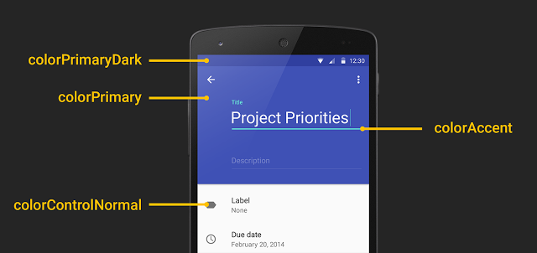
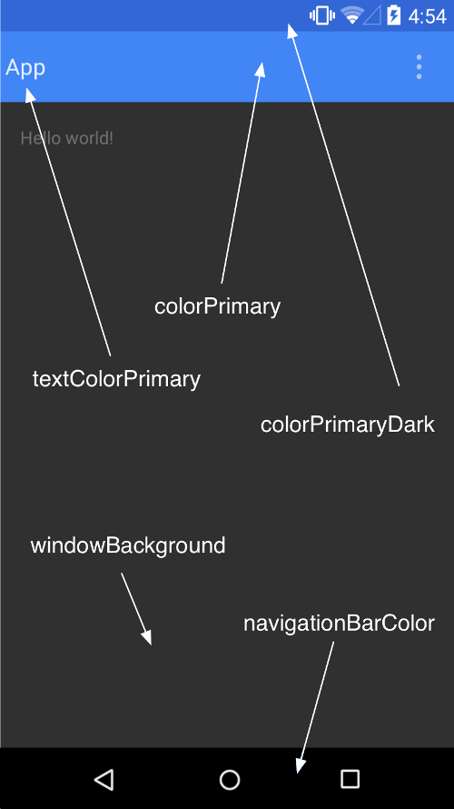
Material Theme

Slide 13
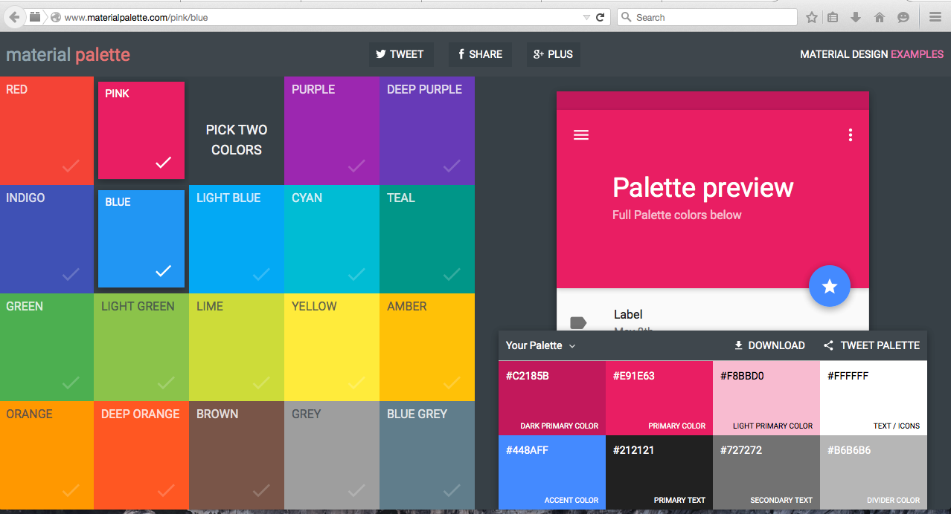
Theme
Choose the Color
www.materialpalette.com/
Overview of selection
Application theme

Slide 14
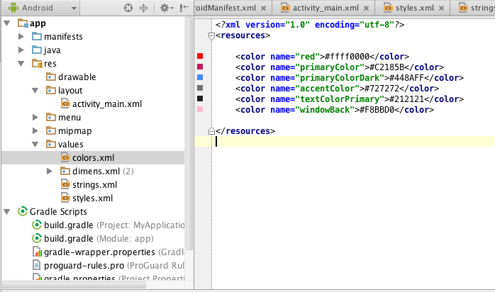
Theme
Set the value in
colors.xml
Overview of selection
Colors values

Slide 15
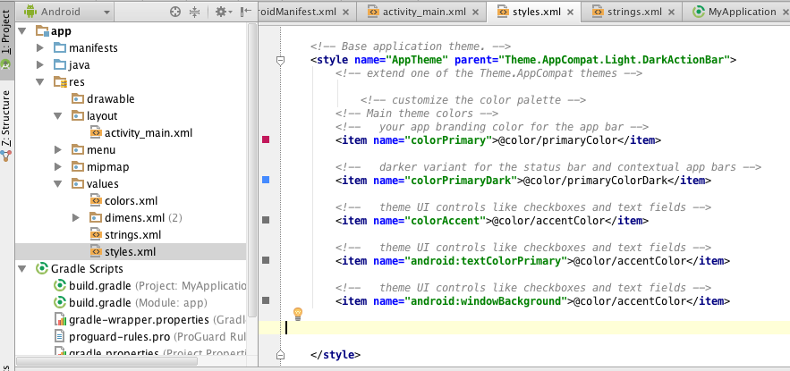
Theme
Apply in styles.xml
Overview of selection
Value Applied

Slide 16
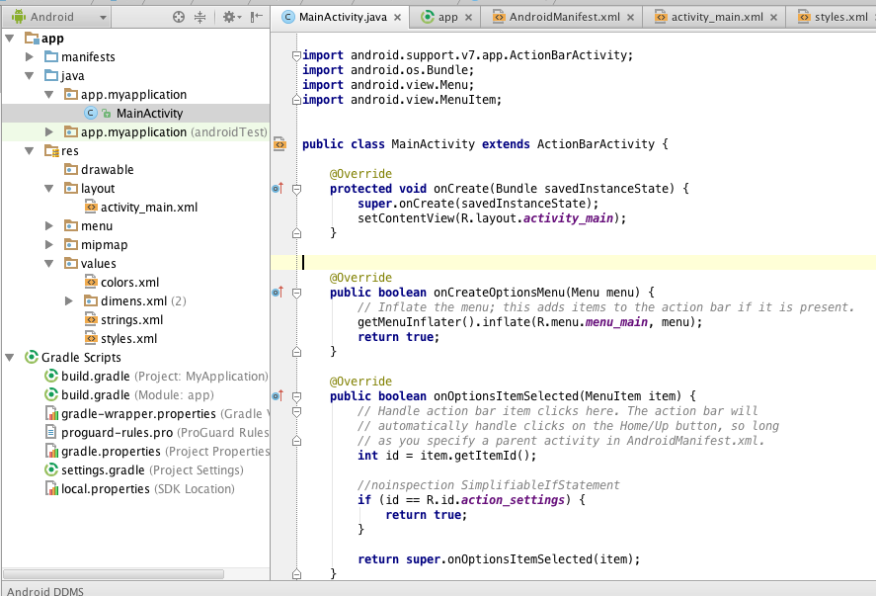
Extend Activities from ActionBarActivity
ActionBarActivity is a subclass of FragmentActivity, so there should be no issues
if you were using FragmentActivity from the older support library:
public class HomeActivity extends ActionBarActivity
{
// Implementation
}

Slide 17
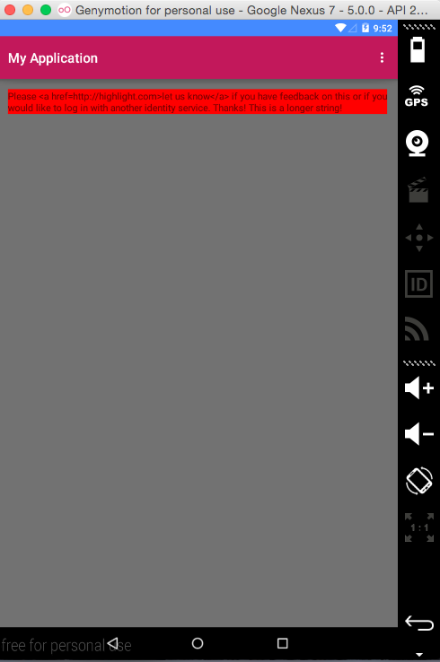
Theme Output

Slide 18
Color Selection
Your application’s color palette brings branding and personality to your app so we’ve made it simple to colorize UI controls by using the following theme attributes:
colorPrimary. The primary branding color for the app; used as the action bar background, recents task title and in edge effects.
colorAccent. Vibrant complement to the primary branding color. Applied to framework controls such as EditText and Switch.
colorPrimaryDark. Darker variant of the primary branding color; applied to the status bar.
Further attributes give fine grained control over colorizing controls, see:
colorControlNormal,
colorControlActivated,
colorControlHighlight,
colorButtonNormal,
colorSwitchThumbNormal,
colorEdgeEffect,
statusBarColor and
navigationBarColor.

Slide 19
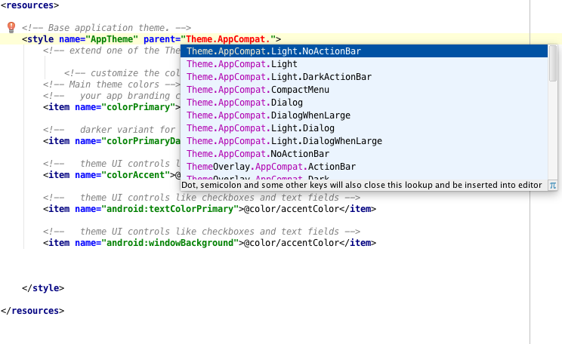
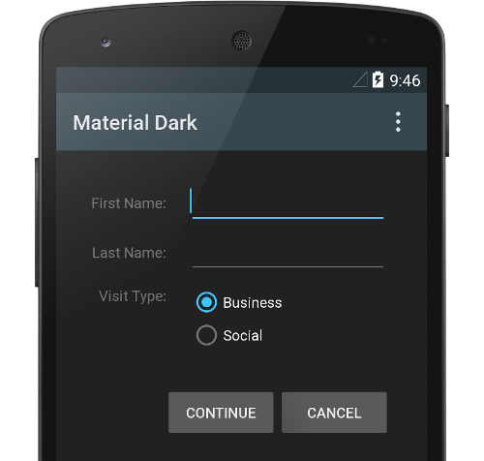
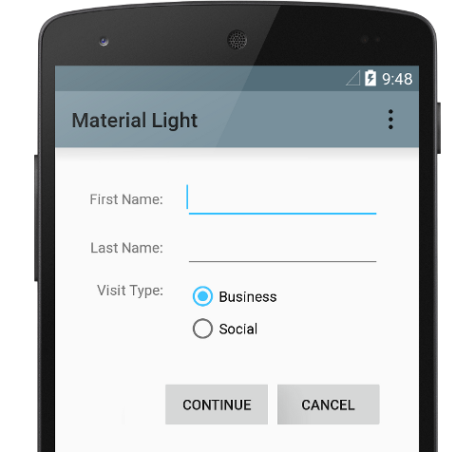
Themes Selection
The available Theme.Appcompat which support material design include the following:
Theme.AppCompat,
Theme.AppCompat.Light,
Theme.AppCompat.Light.DarkActionBar,
Theme.AppCompat.DeviceDefault,
Theme.AppCompat.DeviceDefault.Light,
Theme.AppCompat.DeviceDefault.Light.DarkActionBar.
The material theme is defined as:
@android:style/Theme.Material (dark version)
@android:style/Theme.Material.Light (light version)
@android:style/Theme.Material.Light.DarkActionBar

Slide 20
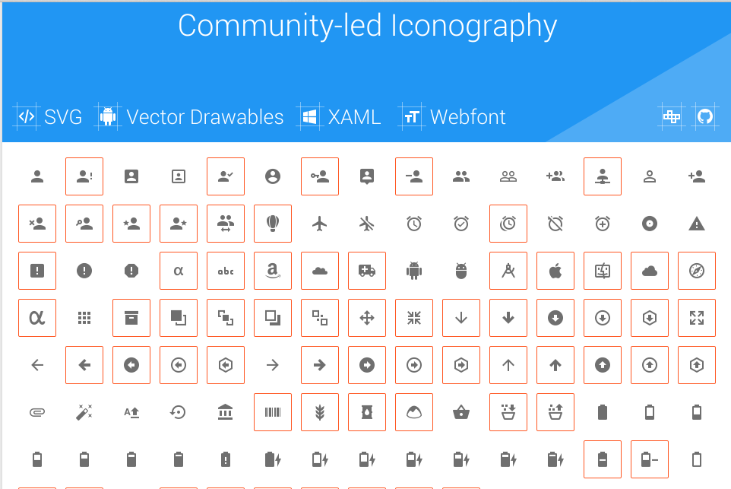
Icons
http://materialdesignicons.com/
Good idea to use them in app to save memory

Slide 21
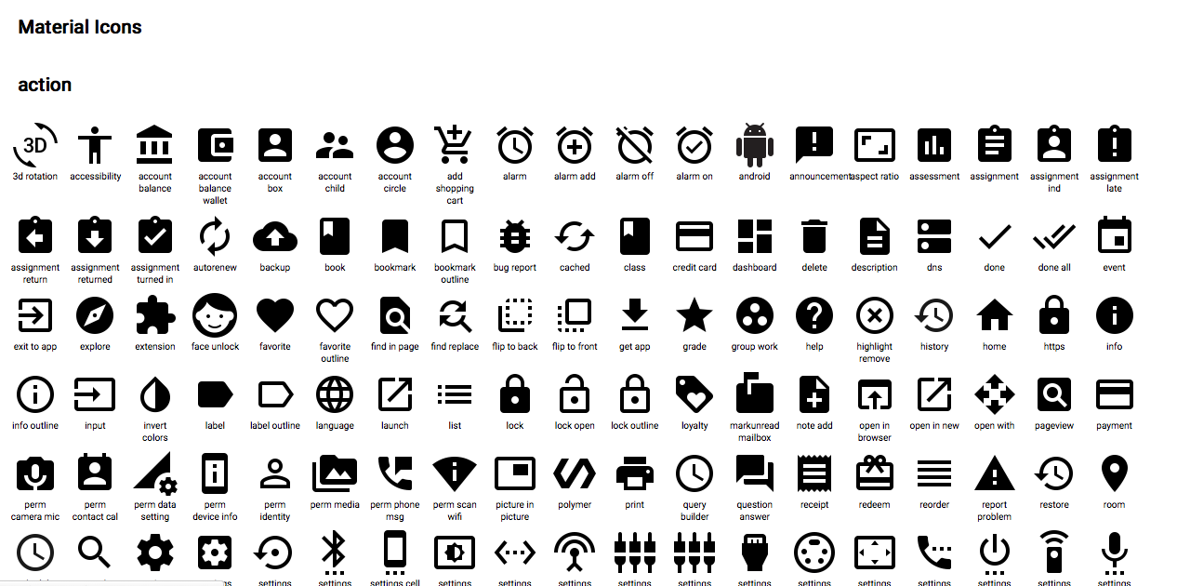
Icons
https://github.com/google/
material-design-icons/
Use system defined one’s
android.R.drawable
@android/drawable.

Slide 22
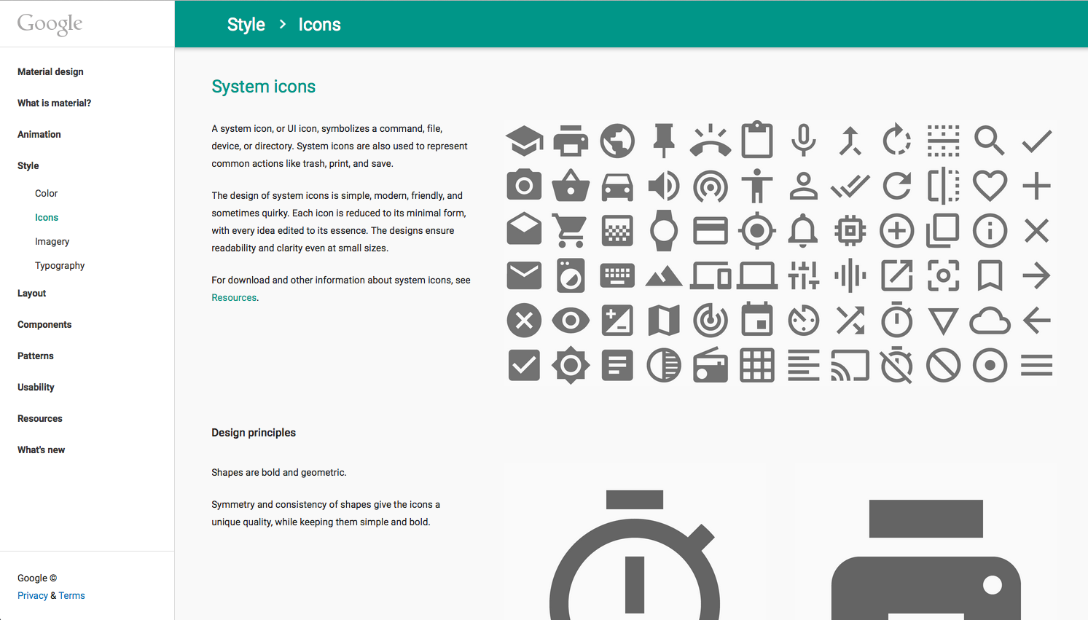
Icons
http://www.google.co.uk/design/
spec/style/icons.html#icons-product-icons

Slide 23
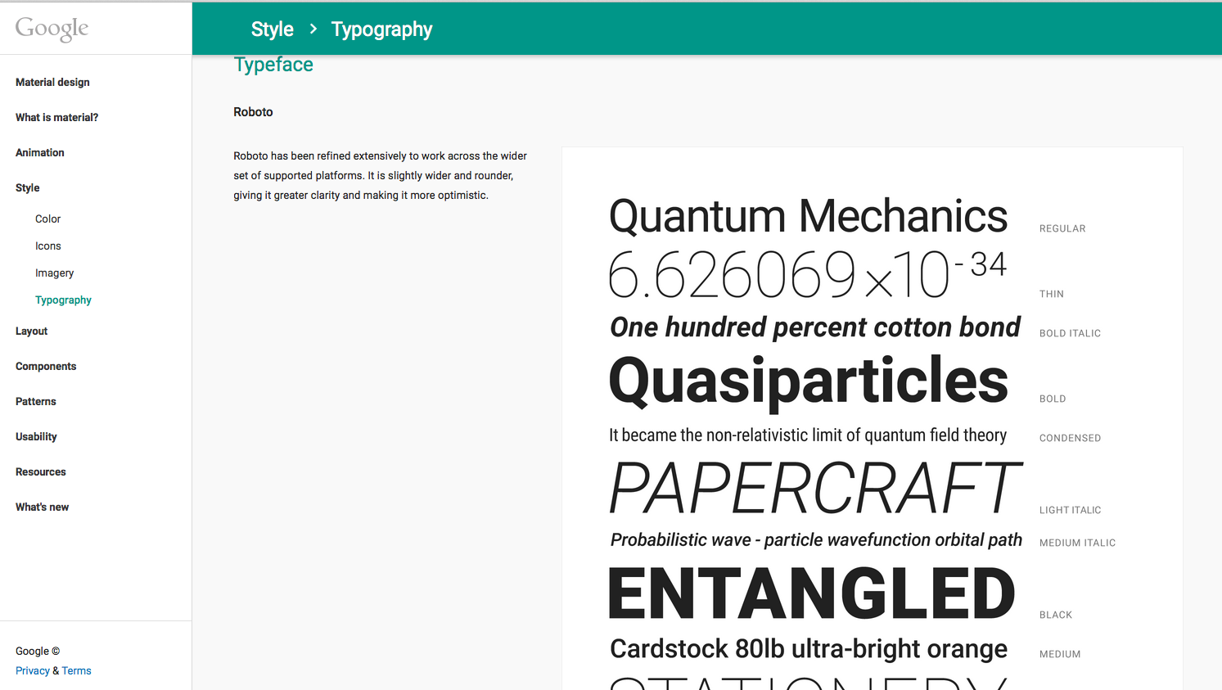
Icons
http://www.google.co.uk/design/spec/
style/icons.html#

Slide 24
Material Design Views
1# ToolBars

Slide 25
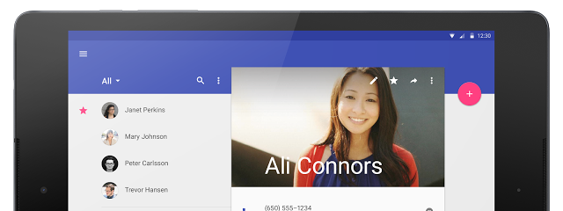
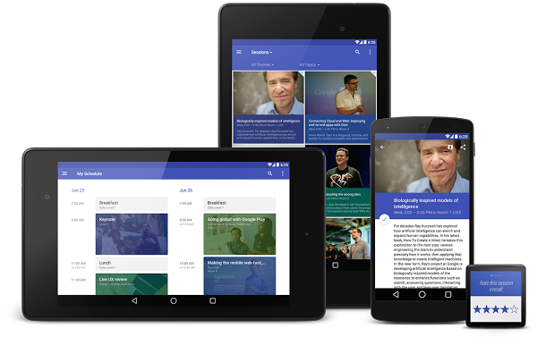
Material ToolBar

Slide 26
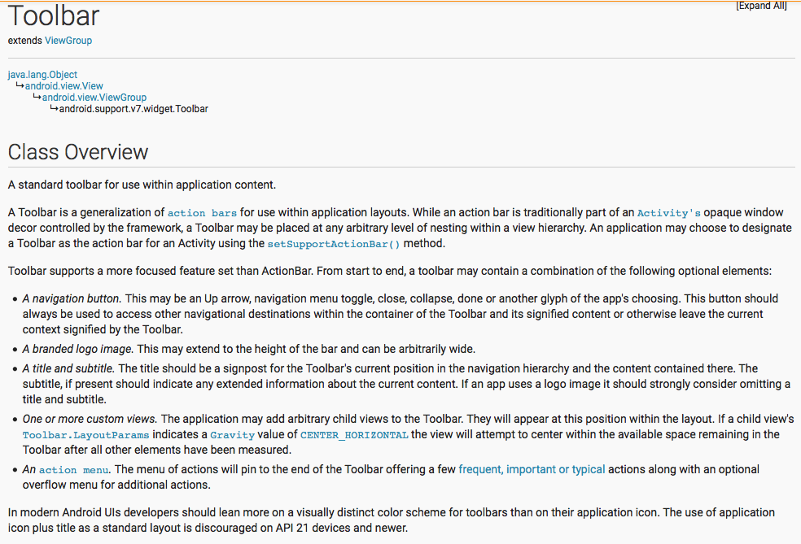
Standalone

Slide 27
ToolBar Basics
ToolBar was introduced in Android Lollipop, API 21 release and is a complete replacement to ActionBar.
It's a ViewGroup so you can place it anywhere in your layout. ToolBar also provides greater control to customize its appearance for the same reason.
ToolBar works well with apps targeted to API 21 and above.
However, Android has updated the AppCompat support libraries so the ToolBar can be used on lower Android OS devices as well.
In AppCompat, ToolBar is implemented in the android.support.v7.widget.Toolbar class.
There are two ways to use Toolbar:
Use a Toolbar as an Action Bar when you want to use the existing Action Bar facilities (such as menu inflation and selection, ActionBarDrawerToggle, and so on) but want to have more control over its appearance.
Use a standalone Toolbar when you want to use the pattern in your app for situations that an Action Bar would not support; for example, showing multiple toolbars on the screen, spanning only part of the width, and so on.

Slide 28
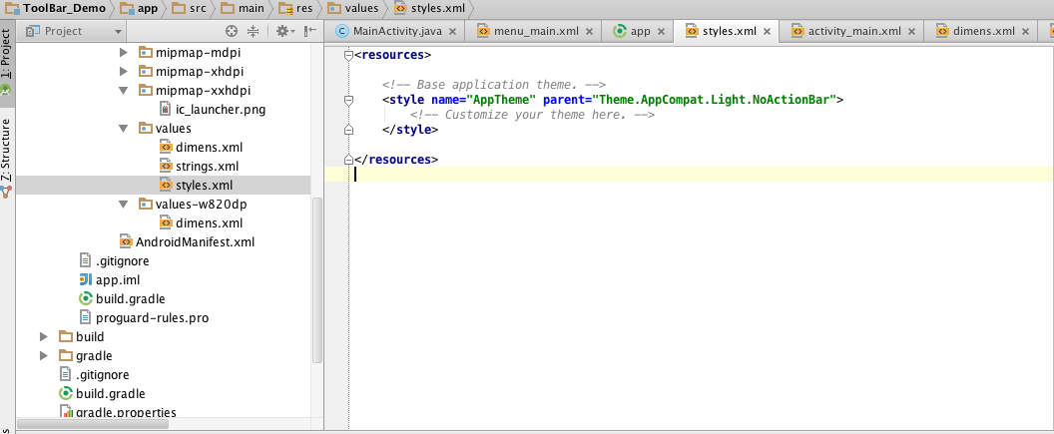
1# Using ToolBar as ActionBar
To use Toolbar as an ActionBar, first disable the decor-provided ActionBar.
The easiest way is to have your theme extend from Theme.AppCompat.NoActionBar (or its light variant) in styles.xml file.

Slide 29
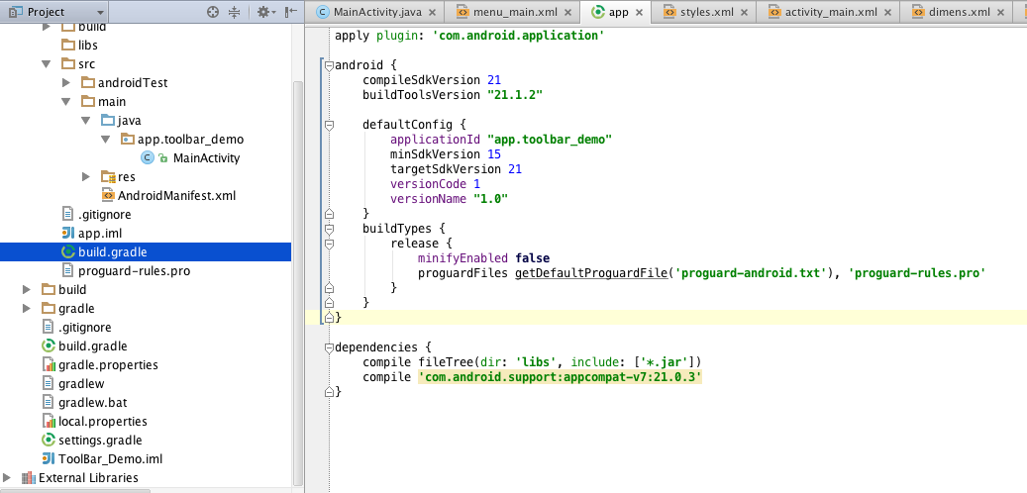
2# AppCompat-v7 support library
Secondly, add the AppCompat-v7 support library to your application build.gradle (Module:app) file:

Slide 30
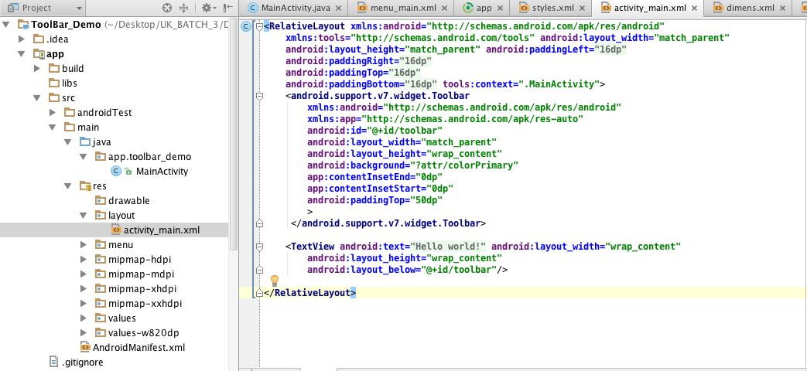
3# Add Toolbar to Activity layout file.
One of the biggest advantages of using the Toolbar widget is that you can place the view anywhere in your layout.
Below it's placed at the top of the RelativeLayout, like the standard ActionBar, but it can be contained in any other type of layout as well.

Slide 31
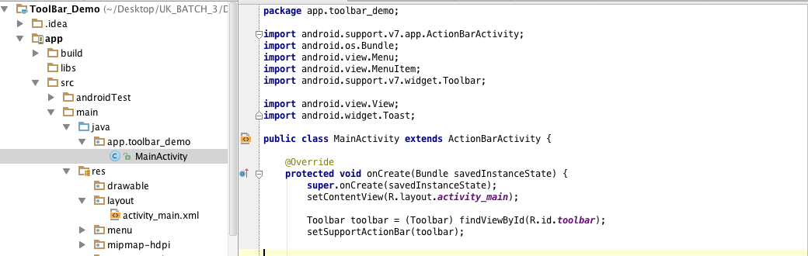
4# Add Toolbar to Activity file.
Then in your Activity or Fragment, set the Toolbar to act as your ActionBar by using the setSupportActionBar(Toolbar) method.
Note: When using the support library, make sure that you are importing android.support.v7.widget.Toolbar and not android.widget.Toolbar.

Slide 32
Standalone
The difference in standalone mode is that you do not set the Toolbar to act as your action bar.
For this reason, you can use any AppCompat theme and you do not need to disable the decor-provided Action Bar.
In standalone mode, you need to manually populate the Toolbar with content/actions.
For instance, if you want it to display actions, you need to inflate a menu into it:

Slide 33
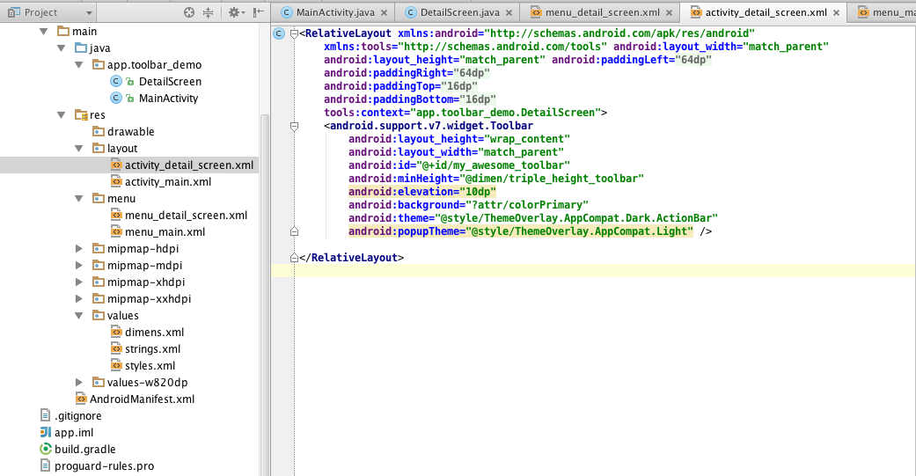
1# Add Toolbar to Activity layout file.

Slide 34
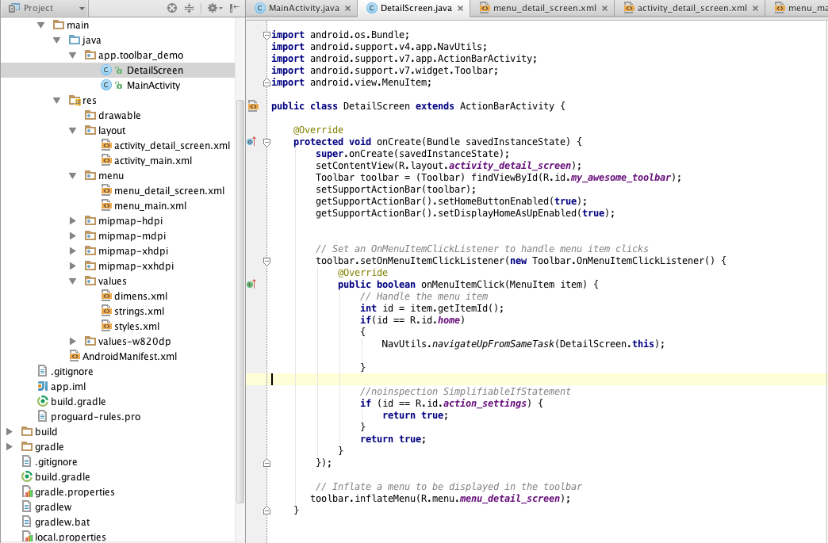
2# Add Toolbar to Activity file

Slide 35
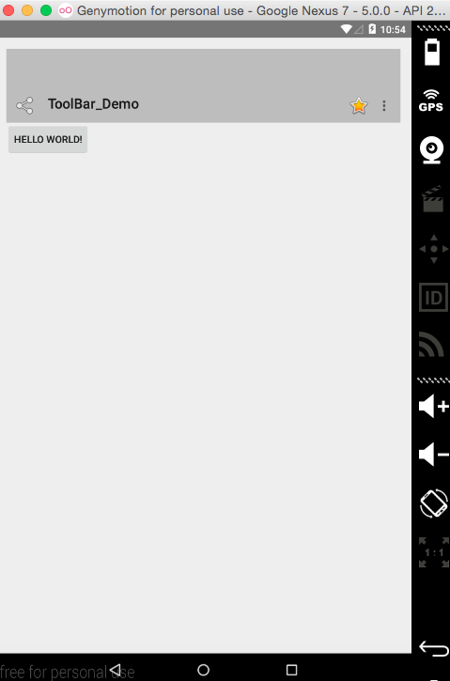
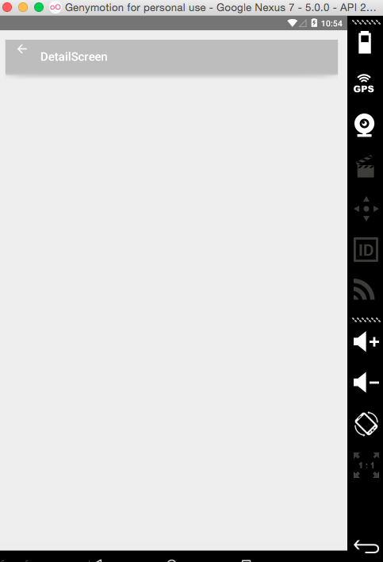
Output

Slide 36
Material Design Views
2# CardView

Slide 37
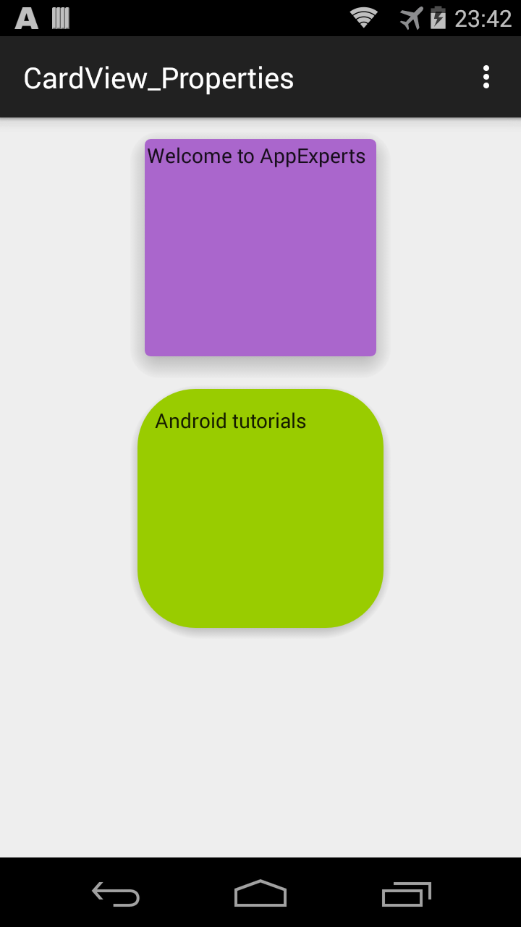
Card Basics
dependencies {
compile fileTree(dir: 'libs', include: ['*.jar'])
compile 'com.android.support:appcompat-v7:21.0.3'
compile 'com.android.support:cardview-v7:21.0.+'
}
<android.support.v7.widget.CardView
xmlns:card_view="http://schemas.android.com/apk/res-auto"
android:id="@+id/card_view1"
android:layout_gravity="center"
android:layout_width="180dp"
android:layout_height="180dp"
card_view:cardCornerRadius="4dp"
card_view:cardBackgroundColor="#AA66CC"
card_view:cardElevation="10dp">
</android.support.v7.widget.CardView>

Slide 38
Material Design Views
3# Recycler View: A better way to display collections in Android

Slide 39
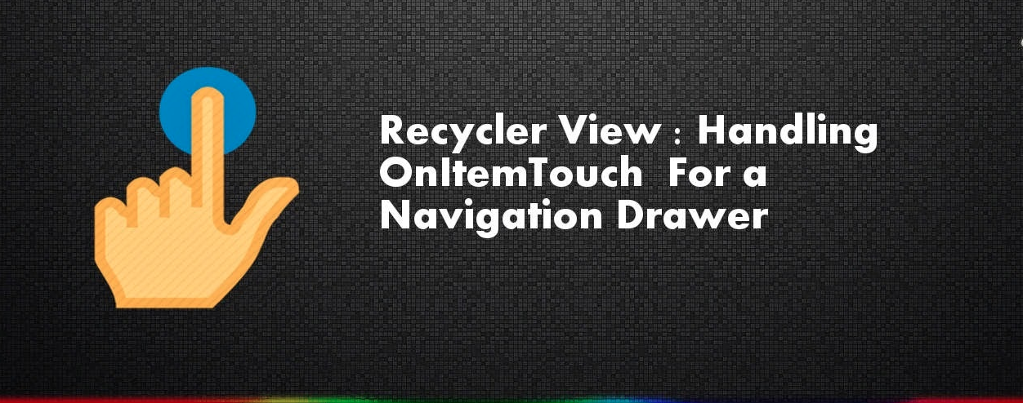

Slide 40
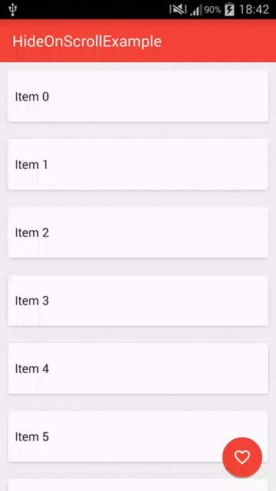
Recycler View Basics
View group for displaying collections.
RecyclerView is an Android widget that displays a collection of items in a list
or a grid, enabling the user to scroll through the collection.
RecyclerView can be thought of as a replacement for the ListView and GridView
widgets in Android.
Like its predecessors, RecyclerView is designed to display a
large data set in a small window, but RecyclerView offers more layout options
Better optimized for displaying large collections.
RecyclerView offers two compelling features:
It has a flexible architecture that lets you modify its behavior by plugging in
your preferred components.
It is efficient with large collections because it reuses item views and requires
the use of view holders to cache view references.

Slide 41
Differences between ListView and RecyclerView
RecyclerView | ListView
Slightly more complex to use and | Easy
You have to write more code to use RecyclerView | Less code
Does not provide a predefined adapter; you must implement the adapter code that accesses your data source | Android includes several predefined adapters that work with ListView and GridView
Does not offer an item-click event when a user taps an item; instead, item-click events are handled by helper classes | By contrast, ListView offers an item-click event.
Enhances performance by recycling views and by enforcing the view-holder pattern, which eliminates unnecessary layout resource lookups | Use of the view-holder pattern is optional in ListView
Based on a modular design that makes it easier to customize. For example, you can plug in a different layout policy without significant code changes to your app | By contrast, ListView is relatively monolithic in structure
Includes built-in animations for item add and remove | ListView animations require some additional effort on the part of the app developer

Slide 42
Differences between ListView and RecyclerView
Classname | Description
RecyclerView.Adapter | Inflates item layouts (instantiates the contents of a layout file) and binds data to views that are displayed within a RecyclerView. The adapter also reports item-click events.
RecyclerView.LayoutManager | Measures and positions item views within a RecyclerView and manages the policy for view recycling.(Linear, Grid, StaggeredGrid)
RecyclerView.ViewHolder | Android includes several predefined adapters that work with ListView and GridView. Looks up and stores view references. The view holder also helps with detecting item-view clicks.
RecyclerView.ItemDecoration | Allows your app to add special drawing and layout offsets to specific views for drawing dividers between items, highlights, and visual grouping boundaries.
RecyclerView.ItemAnimator | Defines the animations that take place during item actions or as changes are made to the adapter.

Slide 43
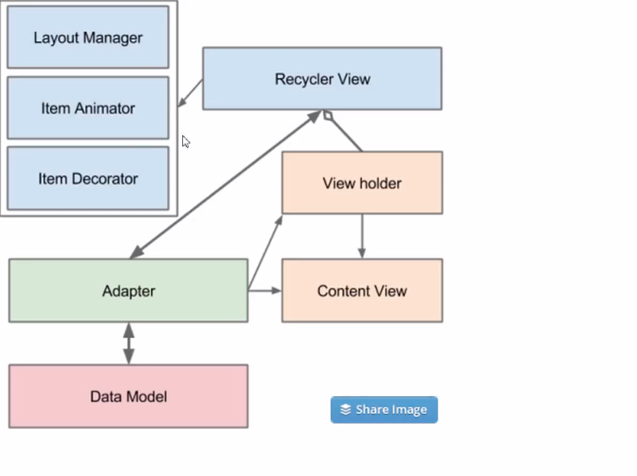
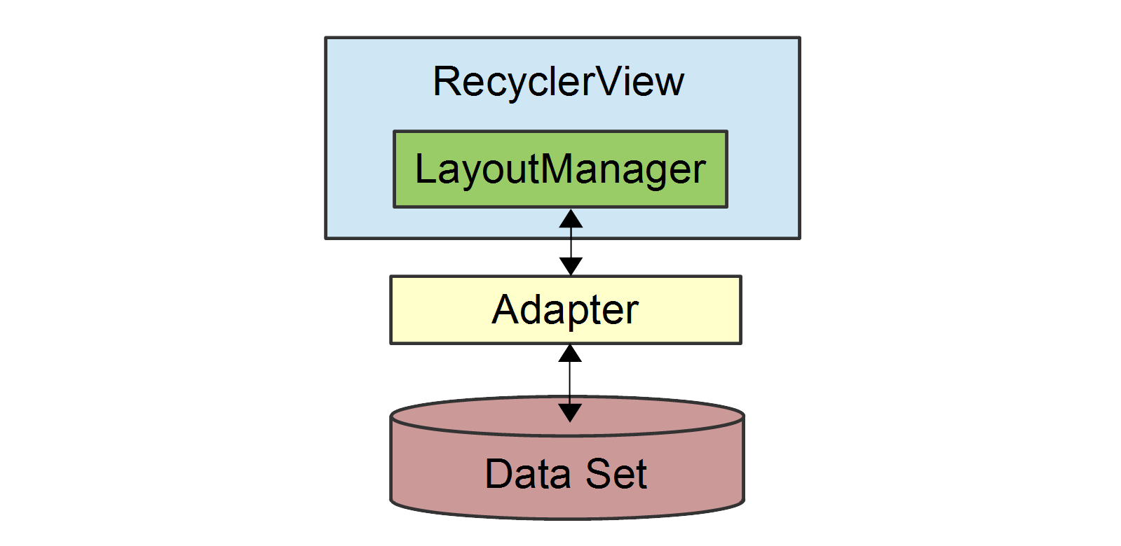
Relationship
The relationship between the RecyclerView, LayoutManager, and Adapter classes

Slide 44
Relationship Basics
As this figure illustrates, the LayoutManager can be thought of as the intermediary between the Adapter and the RecyclerView.
The LayoutManager makes calls into Adapter methods on behalf of the RecyclerView.
For example, the LayoutManager calls an Adapter method when it is time to create a new view for a particular item position in the RecyclerView.
The Adapter inflates the layout for that item and creates a ViewHolder instance (not shown) to cache references to the views at that position.
When the LayoutManager calls the Adapter to bind a particular item to the data set, the Adapter locates the data for that item, retrieves it from the data set, and copies it to the associated item view.

Slide 45
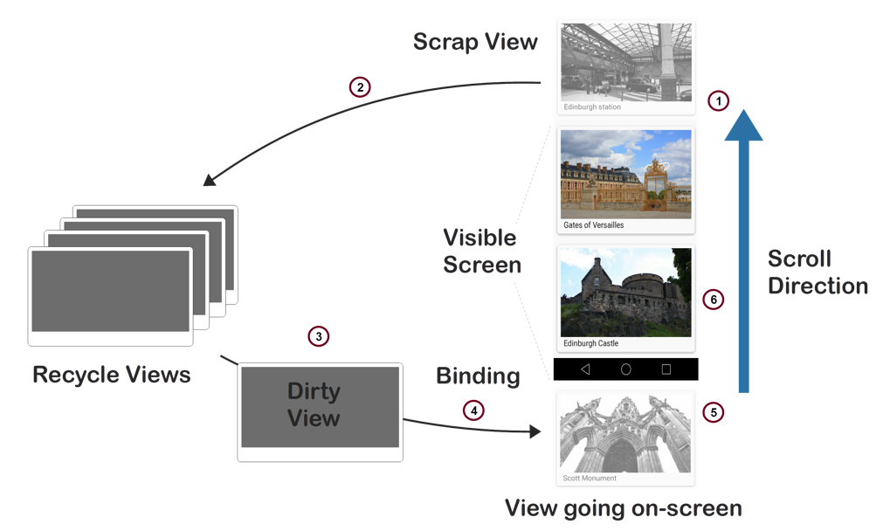
How View Recycling Works

Slide 46
How View Recycling Works
When a view scrolls out of sight and is no longer displayed, it becomes a scrap view.
The scrap view is placed in a pool and becomes a recycle view. This pool is a cache of views that display the same type of data.
When a new item is to be displayed, a view is taken from the recycle pool for reuse. Because this view must be re-bound by the adapter before being displayed, it is called a dirty view.
The dirty view is recycled: the adapter locates the data for the next item to be displayed and copies this data to the views for this item. References for these views are retrieved from the view holder associated with the recycled view.
The recycled view is added to the list of items in the RecyclerView that are about to go on-screen.
The recycled view goes on-screen as the user scrolls the RecyclerView to the next item in the list. Meanwhile, another view scrolls out of sight and is recycled according to the above steps.

Slide 47
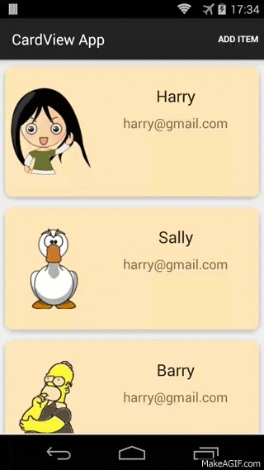
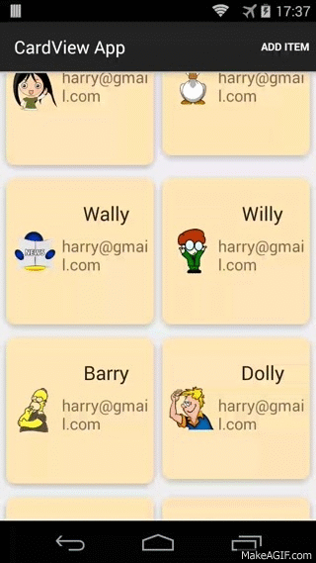
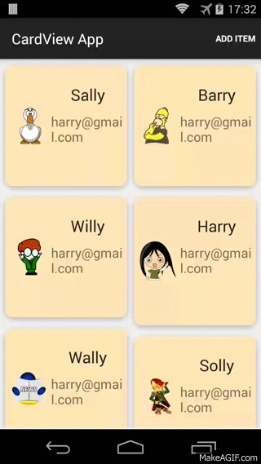
A Basic RecyclerView Example

Slide 48
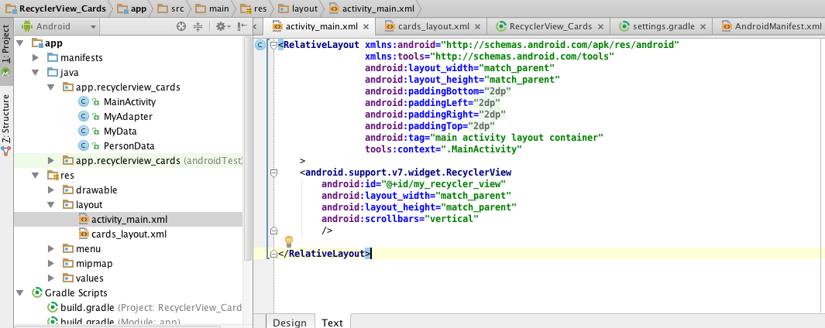
1# Initialization
RecyclerView is packaged in a support library

Slide 49
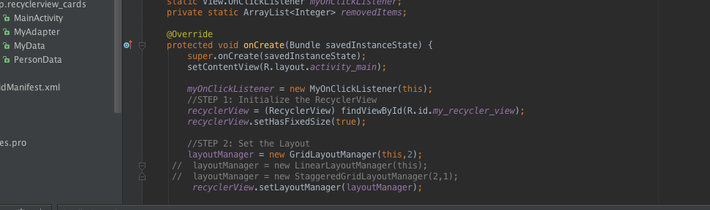
1# Initialization
//STEP 1: Initialize the RecyclerView
//STEP 2: Set the LayoutManager
//STEP 3: Set the Animator
//STEP 4: Set the Adapter

Slide 50
Layout Manager
The layout manager is responsible for positioning items in the RecyclerView display; it determines the presentation type (a list or a grid), the orientation (whether items are displayed vertically or horizontally), and which direction items should be displayed (in normal order or in reverse order).
The layout manager is also responsible for calculating the size and position of each item in the RecycleView display.
The layout manager has an additional purpose: it determines the policy for when to recycle item views that are no longer visible to the user.
Because the layout manager is aware of which views are visible (and which are not), it is in the best position to decide when a view can be recycled.
To recycle a view, the layout manager typically makes calls to the adapter to replace the contents of a recycled view with different data

Slide 51
Layout Manager
RecyclerView provides the following predefined layout managers:
LinearLayoutManager – Arranges items in a column that can be scrolled vertically, or in a row that can be scrolled horizontally.
GridLayoutManager – Displays items in a grid.
StaggeredGridLayoutManager – Displays items in a staggered grid, where some items have different heights and widths.
mLayoutManager = new LinearLayoutManager (this); mRecyclerView.SetLayoutManager (mLayoutManager);

Slide 52
The View Holder
The view holder is a class that we define for caching our view references. The adapter uses these view references to bind each view to its content.
Every item in the RecyclerView has an associated view holder instance that caches the view references for that item.
To create a view holder, we use the following steps to define a class to hold our exact set of views per item:
Subclass RecyclerView.ViewHolder.
Implement a constructor that looks up and stores the view references.
Implement properties that the adapter can use to access these references.

Slide 53
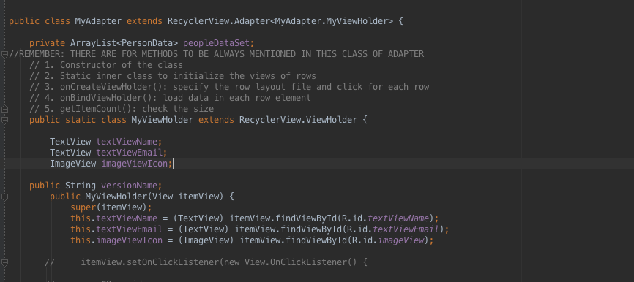
The View Holder
Reference to views

Slide 54
The Adapter
Most of the "heavy-lifting" of our RecyclerView integration code takes place in the adapter.
RecyclerView requires that we provide an adapter derived from RecyclerView.Adapter to access our data source and populate each item with content from the data source.
Because the data source is app-specific, we must implement adapter functionality that understands how to access our data.
The adapter extracts information from the data source and loads it into each item in the RecyclerView collection.
The following drawing illustrates how the sample app adapter maps content in the data source (the photo album) through view holders to individual views within each CardView row item in the RecyclerView:

Slide 55
The Adapter
ViewHolders
Adapters
Images
ROWS
Text
ViewHolders

Slide 56
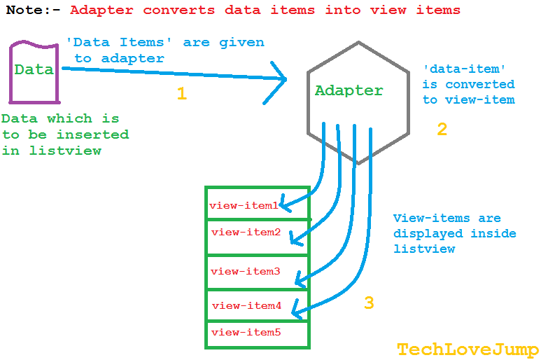

Slide 57
2# Adapter
public class MyAdapter extends RecyclerView.Adapter<MyAdapter.MyViewHolder> {
//REMEMBER: THERE ARE FOR METHODS TO BE ALWAYS MENTIONED IN THIS CLASS OF ADAPTER
// 1. Constructor of the class
// 2. Static inner class to initialize the views of rows
// 3. onCreateViewHolder(): specify the row layout file and click for each row
// 4. onBindViewHolder(): load data in each row element
// 5. getItemCount(): check the size

Slide 58
3#Override the following RecyclerView.Adapter methods
Next, we must override the following RecyclerView.Adapter methods:
OnCreateViewHolder – Instantiates the item layout file and view holder.
OnBindViewHolder – Loads the data at the specified position into the views whose references are stored in the given view holder.
ItemCount – Returns the number of items in the data source.
The layout manager calls these methods while it is positioning items within the RecyclerView.

Slide 59
3#OnCreateViewHolder
The layout manager calls OnCreateViewHolder when the RecyclerView needs a new view holder to represent an item.
OnCreateViewHolder inflates the item view from the view's layout file and wraps the view
This layout represents a single row item in the RecyclerView.
OnBindViewHolder (described below) copies data from the data source into the ImageView and TextView of this layout. OnCreateViewHolder inflates this layout for a given photo location in the RecyclerView

Slide 60
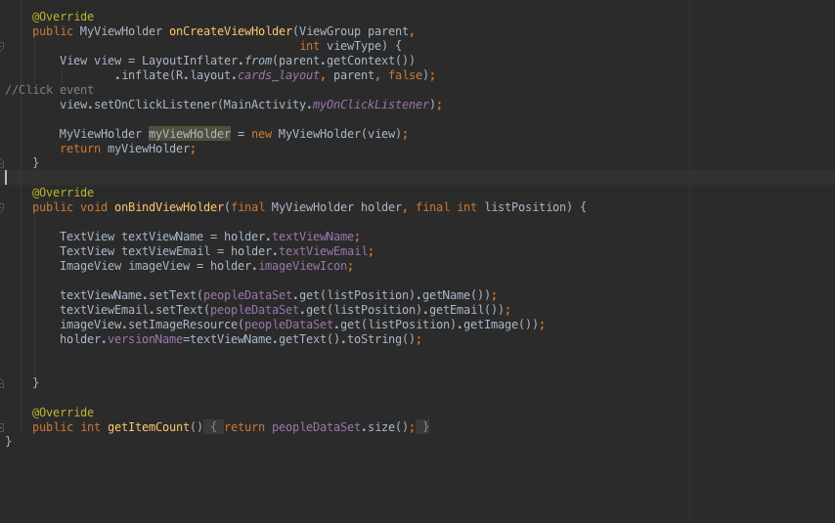
3#OnCreateViewHolder
Reference to row layout
Fills data for each row
Returns size of dataset

Slide 61
3#OnBindViewHolder
When the layout manager is ready to display a particular view in the RecyclerView's visible screen area, it calls the adapter's OnBindViewHolder method to fill the item at the specified row position with content from the data source.
Notice that OnBindViewHolder is the code that deals directly with the structure of the data. In this case, OnBindViewHolder understands how to map the RecyclerView item position to its associated data item in the data source.

Slide 62
FAB

Slide 63
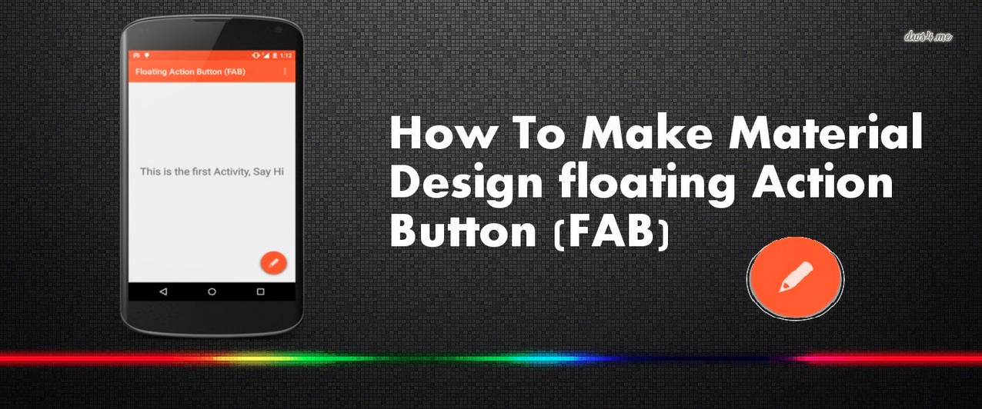
Floating Action Button

Slide 64
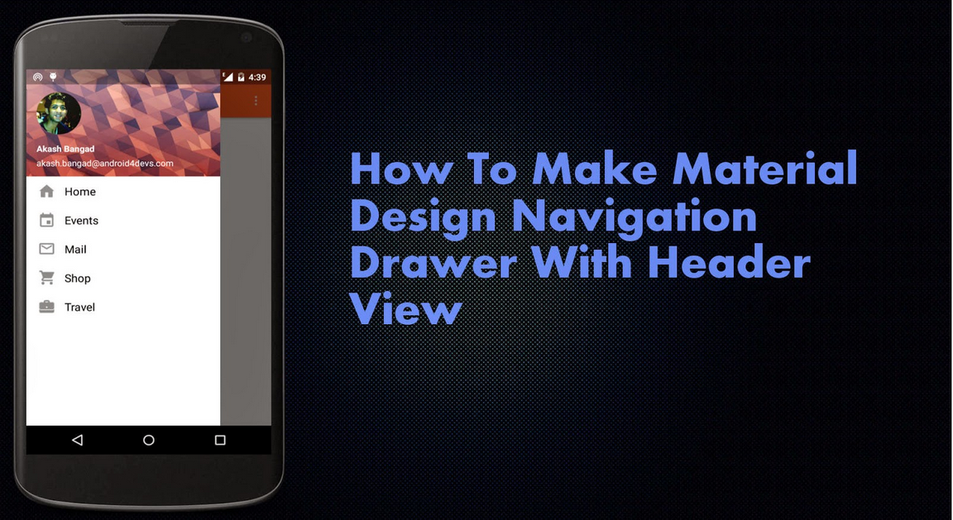
Floating Action Button

Slide 65
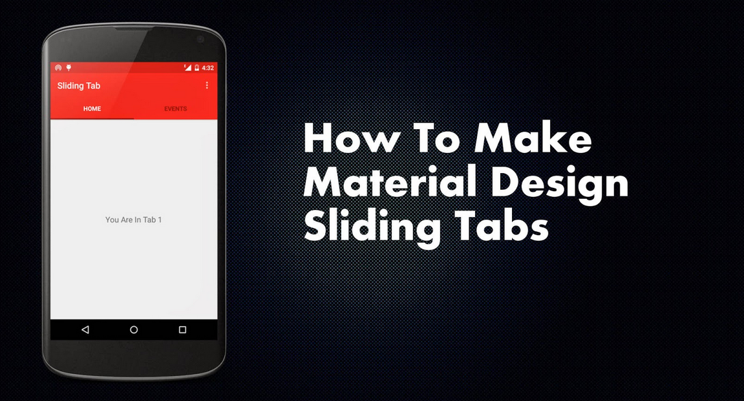

Slide 66
Activity Transactions

